Slide 1

CIS 5220: Research Report: Summary of the ARM Cortex-A9 Architecture
Bernice Templeman

Slide 2
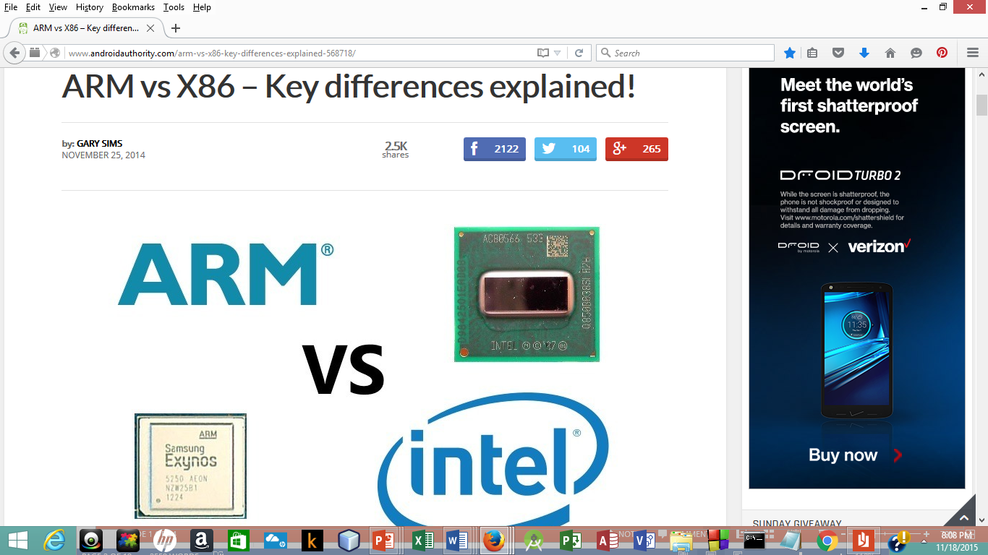
Introduction
While researching computer architectures, I found some that are used on mobile devices.
Android has the worldwide majority of mobile devices
Android supports 3 different processor architectures:
ARM,
Intel and
MIPS.
ARM-based chips are in almost 60 percent of the world’s mobile devices

Slide 3
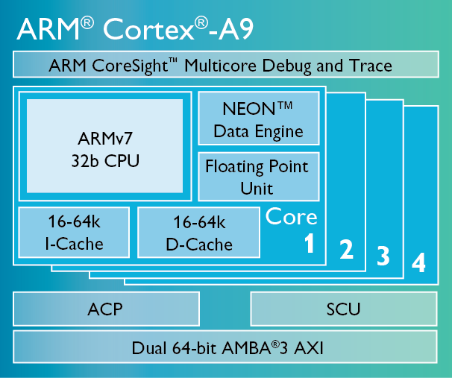
The ARM Cortex-A9 is widely used and stable
My goal is to provide a summary of the ARM Cortex-A9 architecture by discussing the hardware features.
I will be talking about:
My Architecture Selection
Arm Cortex-A9 Architecture Overview
Analysis
CPU & Registers
ALU
FPU
Cache
MMU
Main Memory Architecture
Instruction Fetch & Decode Unit
Special & Interesting Features
MPCore
GPU Compute
Big.LITTLE
Summary

Slide 4

2. Architecture Selection
I selected an architecture I want to learn more about.
When I decided to go back to school to update my computer skills, I talked to an advisor at Miami Dade College and she recommended Mobile Application Development.
I started researching the career and decided that I do want to go into software development .
Why?
It is currently rated as one of the best jobs
Software developers are in high demand
There is a good job outlook
It pays well.
And I also enjoy programming.

Slide 5
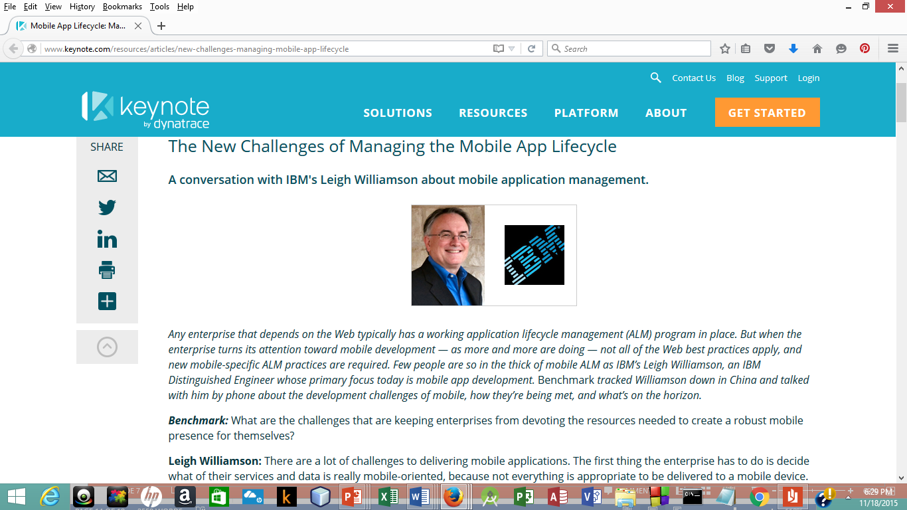
There is also a high demand for mobile application developers.
I decided to focus on Mobile Applications Development.

Slide 6


There are more Mobile Devices than People:
People in the World
Mobile Devices in the World

Slide 7
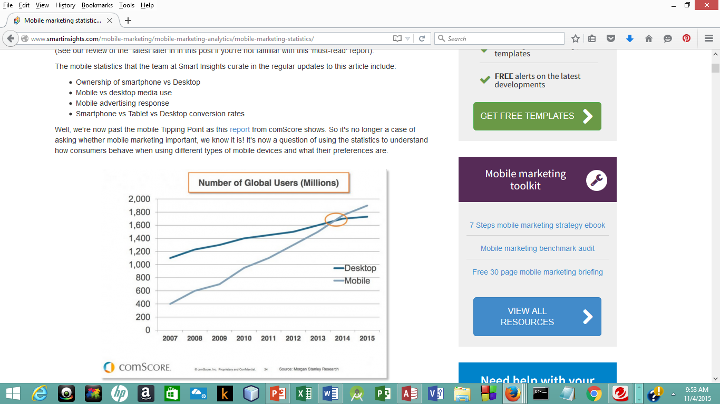
The number of Mobile Devices has passed the number of Desktops.
The majority of devices are ARM.

Slide 8
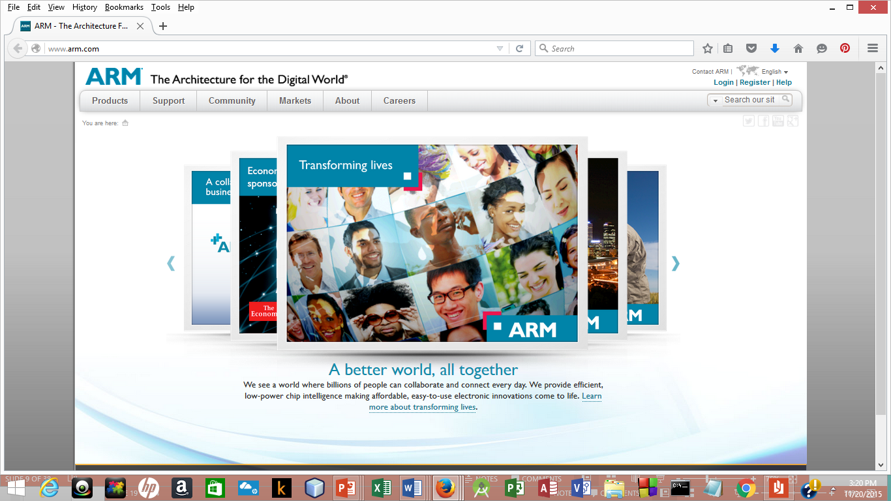
Who is ARM?
ARM Ltd (the Company) began in 1990.
It came out of Acorn Computers who first developed the ARM processor in 1985.
ARM = Advanced RISC Machine
ARM does not sell silicon(chips)… It sells IP (Intellectual Property.)
ARM (with their partners) has sold over 60 BILLION chips.

Slide 9
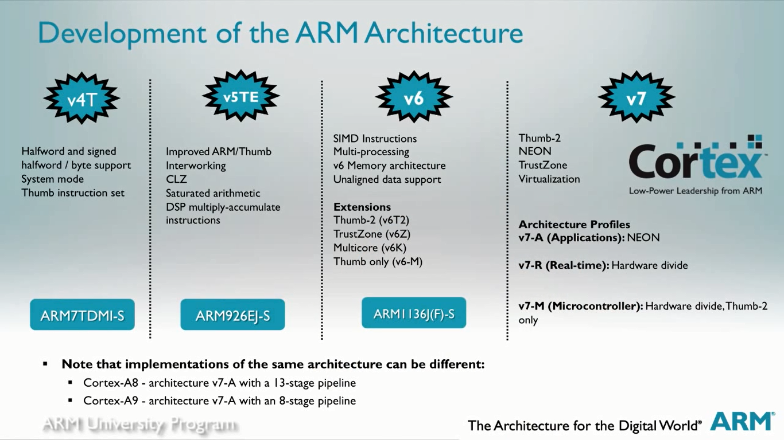
Deciding on an ARM architecture…
First I decided on the ARM’s latest architecture ARMv7.
I choose The “Cortex-A” version for Applications.
A: Applications
R: Real-time
M: Micro-Controller
I choose CORTEX-A9 because it is currently widely used & stable.

Slide 10
3. Architecture Overview
Architecture CPU: ARMv7
Multicore: 1-4 Cores
Key Features:
ARM instructions: 32-bit
Thumb®-2 Technology :16/32 bit Instruction Set
NEON™ Data Engine: (optional) Advanced SIMD. SIMD is Single Instruction Multiple Data. This improves multimedia performance.
FPU (optional):
Level 1 Caches: includes both I-cache & D-cache
Level 2 Cache Controller: (optional)

Slide 11
Advanced Multicore Technologies:
SCU (Snoop Control Unit)
ACP (Accelerator Coherency Port)
AMBA® (Advanced Microcontroller Bus Architecture)
GIC (Generic Interrupt Controller)
Jazelle® RCT & DBX Technology

Slide 12
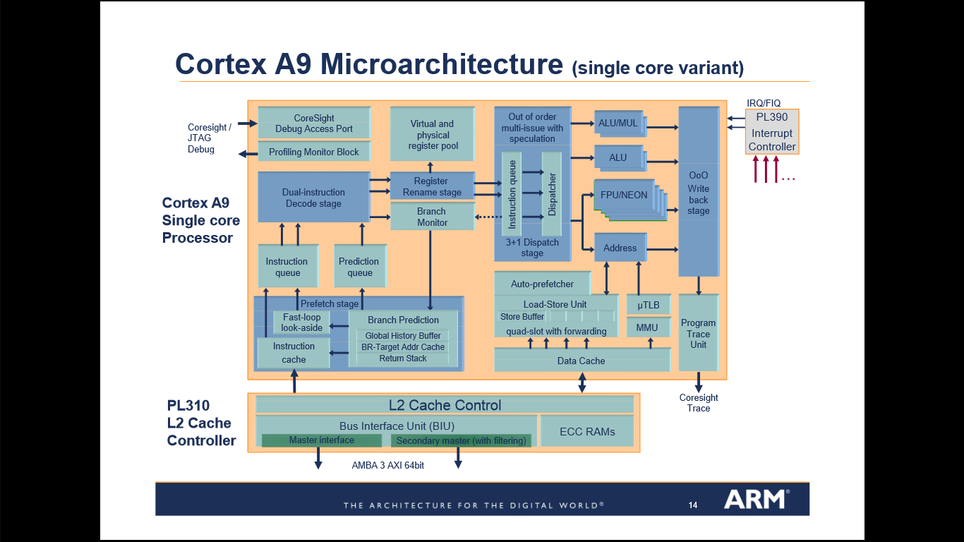
4. Architecture Analysis

Slide 13
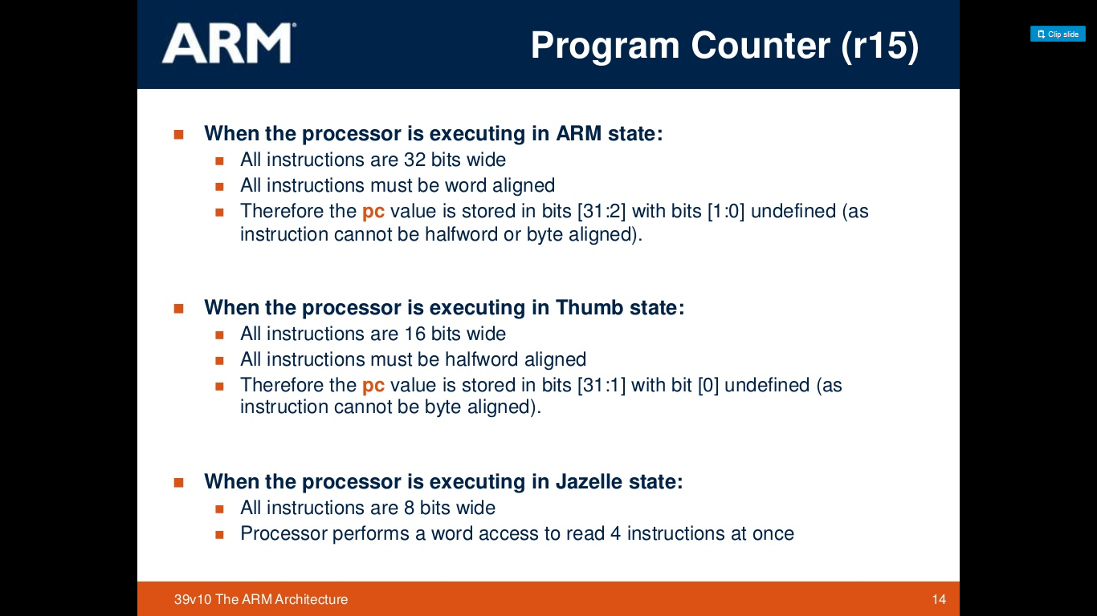
4.1 Central Processing Unit (CPU)
ARM is based on the RISC Architecture because it has:
A uniform register file load/store architecture,
data processing operates only on register contents, not directly on memory contents.
Simple addressing modes,
Enhancements to a basic RISC architecture enable ARM processors to achieve a good balance of high performance, small code size, low power consumption and small silicon area.
Instruction sets:
The ARM Instruction set is a 32-bit instructions
The ARM Thumb-2 instruction set is 16/32 bit
Jazelle: 8-bit instructions to execute Java Bytecode

Slide 14
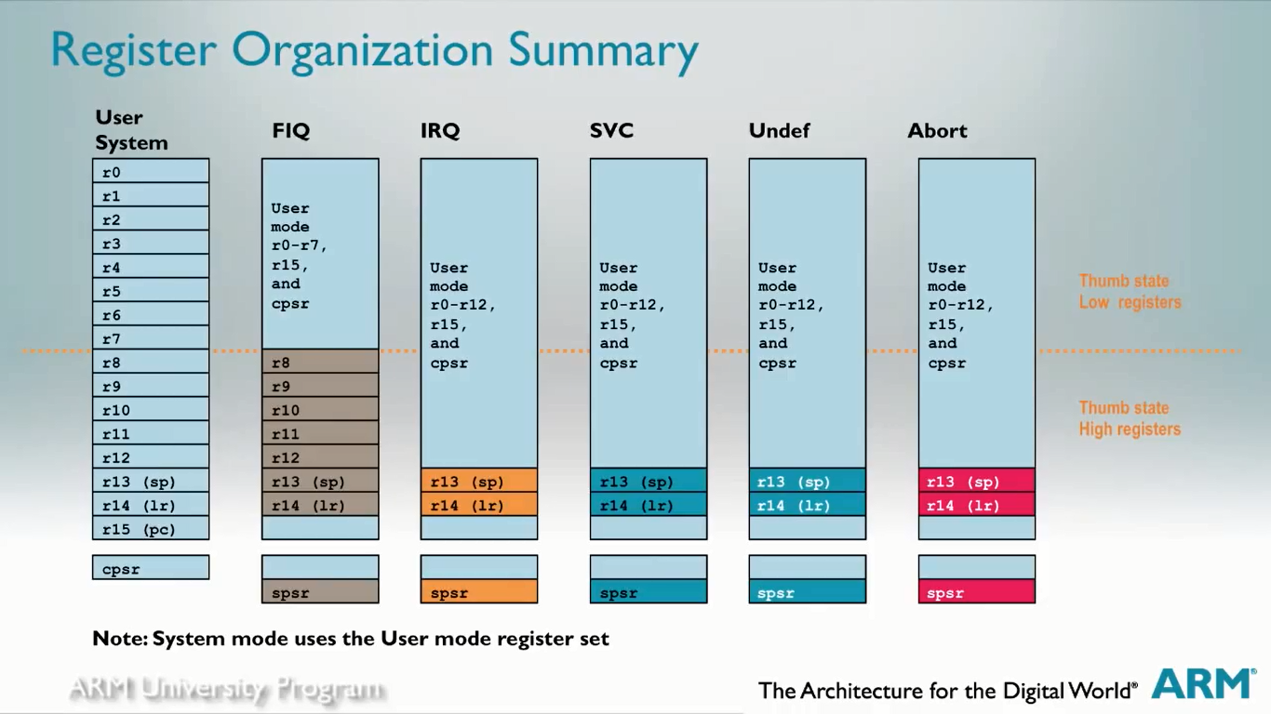
CPU has 7 Processor Modes:
Each mode has access to its own stack and a subset of registers.
All modes except System & User are Exception modes.
Modes:
Supervisor (SVC) is entered on reset and when a SVC instruction is executed.
FIQ is entered when a high priority (fast) interrupt is raised.
IRQ is entered when a normal priority interrupt is raised.
Abort is used to handle memory access violations.
Undef is Used to handle undefined instructions.
System is the Privileged mode using the same registers as User mode.
User is the mode under which most Applications / OS tasks run.

Slide 15
Registers
there are 37 registers, all 32 bits long.
A subset of these registers is accessible in each mode. (They are banked)
Most thumb instructions can only use the lower 8 registers
Registers:
r0 –r12 are the general purpose registers
r13 is the sp (stack pointer)
r14 is the lr (link register)
r15 is the pc (program counter)
CPSR (Current Program Status Register)
SPSR (Saved Program Status Register)

Slide 16
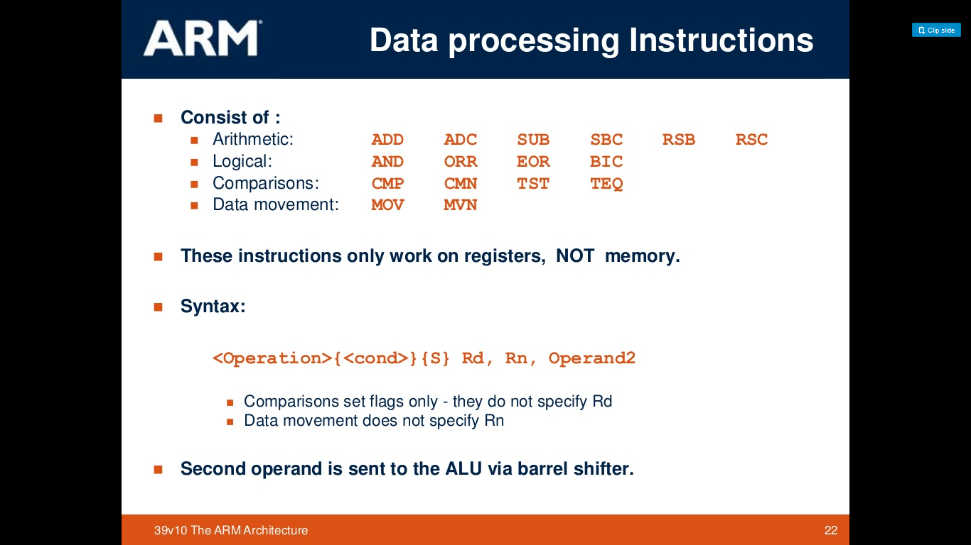
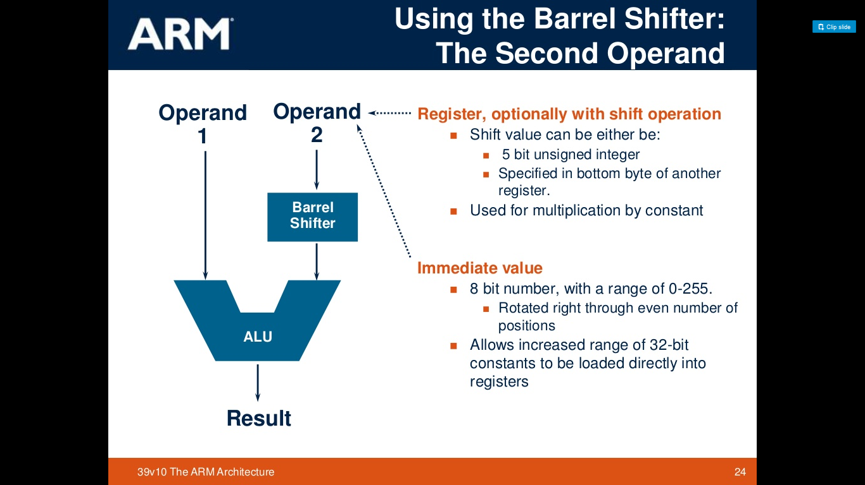
4.2 Arithmetic Logic Unit (ALU) The ARM arithmetic logic unit has a 32-bit barrel shifter that is capable of shift and rotate operations The 32 bit Thumb instructions have almost the same access as ARM instructions The 16 bit thumb instructions only allow access to the barrel shifter with separate instructions

Slide 17
4.3 FPU
The VFP (Floating point unit) is Optional
it is hardware support for floating point operations in half-, single- and double-precision floating point arithmetic.
It has its own registers & instruction set
It is fully IEEE 754 compliant with full software library support.
The FPU is used for a wide range of applications:
PDAs and smartphones for graphics, voice compression and decompression, user interfaces, Java interpretation, and Just In Time (JIT) compilation
games machines for three-dimensional graphics and digital audio
printers and MultiFunction Peripheral (MFP) controllers for high-definition color rendering
set-top boxes for digital audio and digital video, and three-dimensional user interfaces
automotive applications for engine management and power train computations.
F
P
U

Slide 18
4.4 Cache
The L1 memory system has:
separate instruction and data caches each with a fixed line length of 32 bytes
64-bit data paths throughout the memory system
support for four sizes of memory page
export of memory attributes for external memory systems
support for Security Extensions.

Slide 19
Cache Features
To reduce power consumption, the number of full cache reads is reduced by taking advantage of the sequential nature of many cache operations
Instruction cache features
The instruction cache is virtually indexed and physically tagged.
Data cache features:
The data cache is physically indexed and physically tagged.
Store buffer
The Cortex-A9 processor has a store buffer with four 64-bit slots with data merging capability.
Instruction
data

Slide 20
L2 Cache Control
L2 Cache Control is optional.
The Cortex-A9 L2 interface consists of two 64-bit wide AXI bus masters:
M0 is the data side bus
M1 is the instruction side bus and has no write channels.
Ensures high data throughput and maximum performance
L2 Cache
Shared, unified
Off-chip
128KB to 8 MB
4 to 16-way associative
Provides low-latency and high-bandwidth access to up to 8MB of cached memory in high-frequency designs, or designs needing to reduce the power consumption associated with off-chip memory access.
L2 Cache Control

Slide 21
4.5 Memory Management Unit (MMU)
The MMU works with the L1 and L2 memory system to translate virtual addresses to physical addresses.
It also controls accesses to and from external memory.
A translation lookaside buffer (TLB) is a memory cache that stores recent translations of virtual memory to physical addresses for faster retrieval. When a virtual memory address is referenced by a program, the search starts in the CPU.
TLB

Slide 22
4.6. Main Memory Architecture
ARM has switched from a von Neumann Architecture to a Harvard Architecture.
The main characteristic of the Harvard Architecture is that it has physically separate signals and storage for instruction and data memory/cache.
It is possible to access program memory and data memory simultaneously.
instruction memory is read-only and
data memory is read-write.
Therefore, it is impossible for program contents to be modified by the program itself.
.

Slide 23
4.7 Instruction Fetch and Decode
Fetch
Decode
Rename
Issue/Dispatch
Execute
Memory
Write Back
Fetch

Slide 24
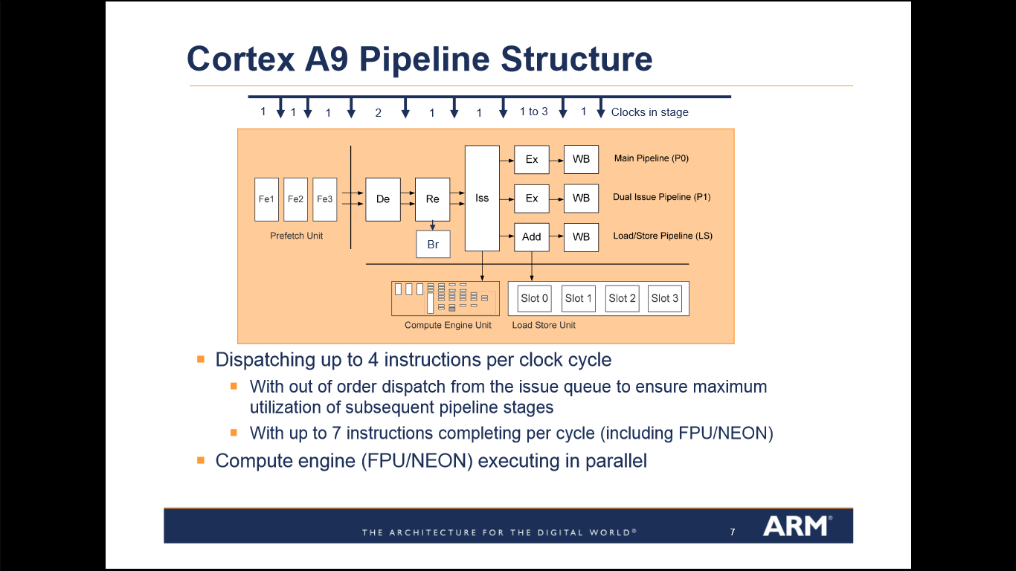
Pipeline
The pipeline is
dual-issue superscalar, and
out-of-order dispatch,
dynamic length (8 – 11 stages).

Slide 25
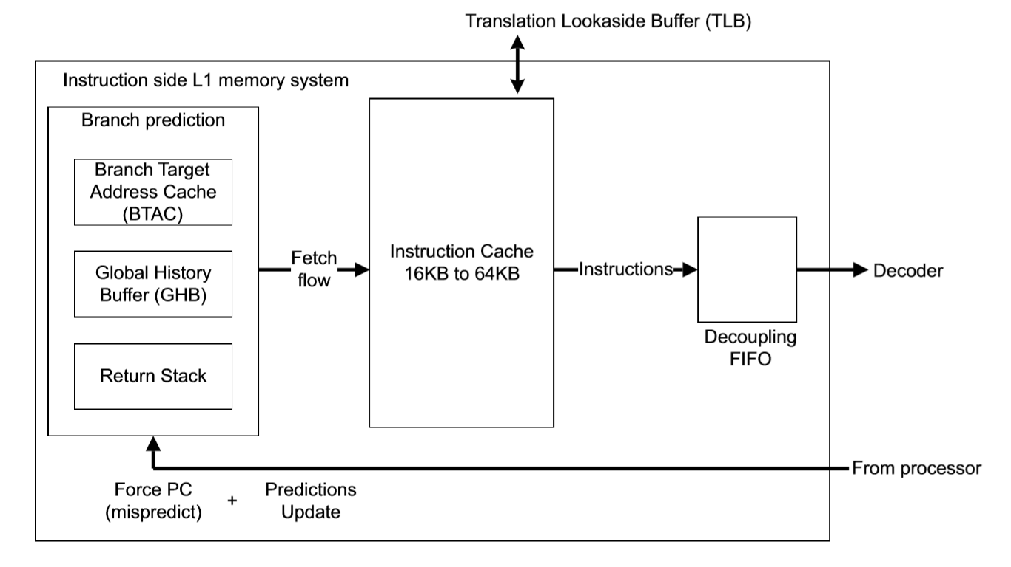
Instruction Fetch
The L1 instruction side memory system provides an instruction stream to the Cortex-A9 processor.
To increase overall performance and to reduce power consumption,
it contains the following functionality:
dynamic branch prediction
instruction caching.

Slide 26
Decode, Rename, Issue, Execute
R
E
N
A
M
E
I
S
S
U
E
E
X
E
C
U
T
E
Decode:
Dual Instruction Decode Stage
Rename:
register renaming from virtual to physical register pool
Issue:
Out of Order dispatch
Multi-issue with speculation
Execute (1-3 cycles):
Most instructions execute in one cycle
Decode

Slide 27
Data Memory System
The micro TLB produces the physical address from the virtual address before performing the cache access.
dependent load-store instructions forwarded for resolution within memory system
2-level TLB structure
micro TLB
main TLB
TLB

Slide 28
Write Back Stage
Out of Order Write back of Instructions
Write Back

Slide 29
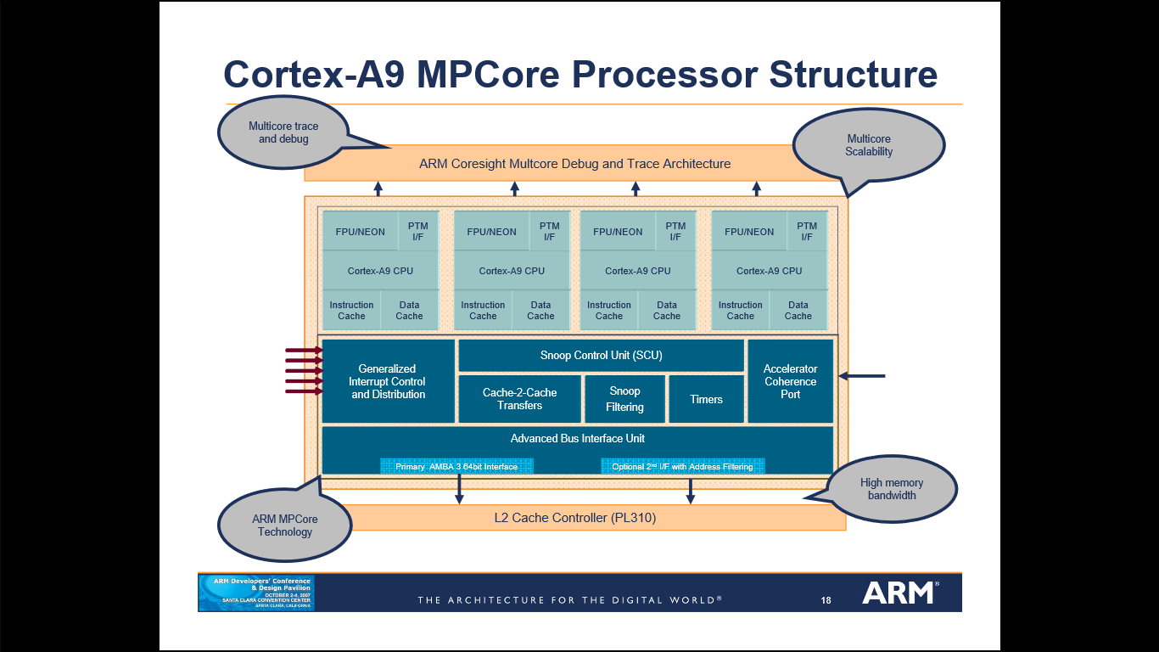
5. Special or Interesting Features: Multi-Processing
Moving from a single core to a multiple processor structure gets more interesting.
Each core has its own L1 cache, but the L2 cache is shared.
Advanced Snoop Control Unit supports enhanced cache coherence
Accelerator Coherance Port
Advanced Bus Interface Unit
TrustZone technology with interrupt virtualization
Generalized Interrupt Controller (GIC)

Slide 30
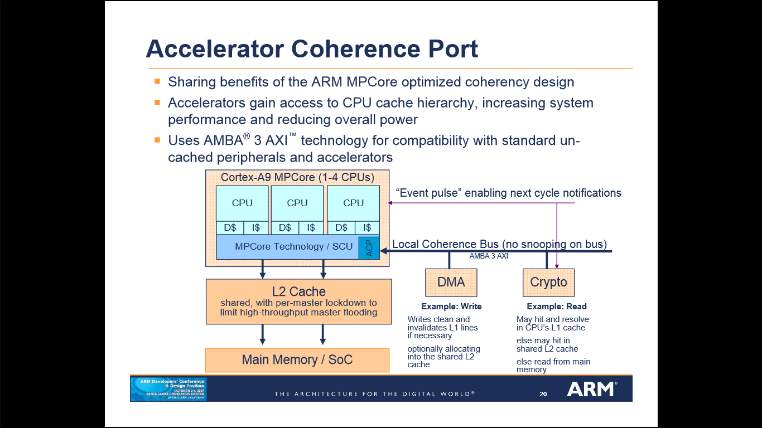
Accelerator Coherence Port (ACP)
The Accelerator Coherence Port
enables the sharing of benefits

Slide 31
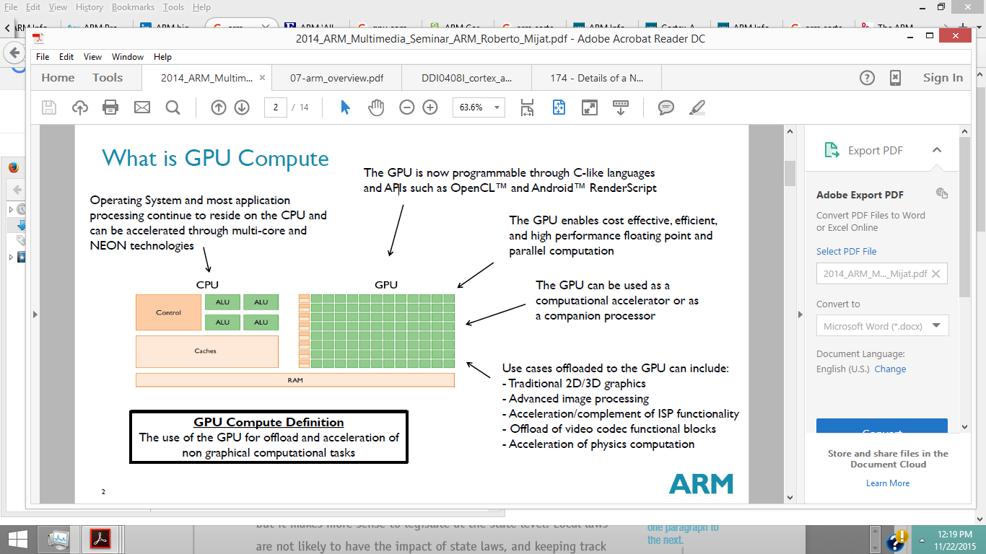
Special or Interesting Features: GPU Compute
GPU (Graphics Processor Unit) Compute:
GPU compute is used today primarily to make games play better and to make pictures look better
In the next few years, GPU computing will get even better as standards gel, programming becomes more standard and simple, and the performance rises. This will enable even more powerful and quicker image processing, 4K video editing and effects, super-resolution, improved voice control, security and thoroughly enhanced augmented reality,
all without decreasing battery life.

Slide 32
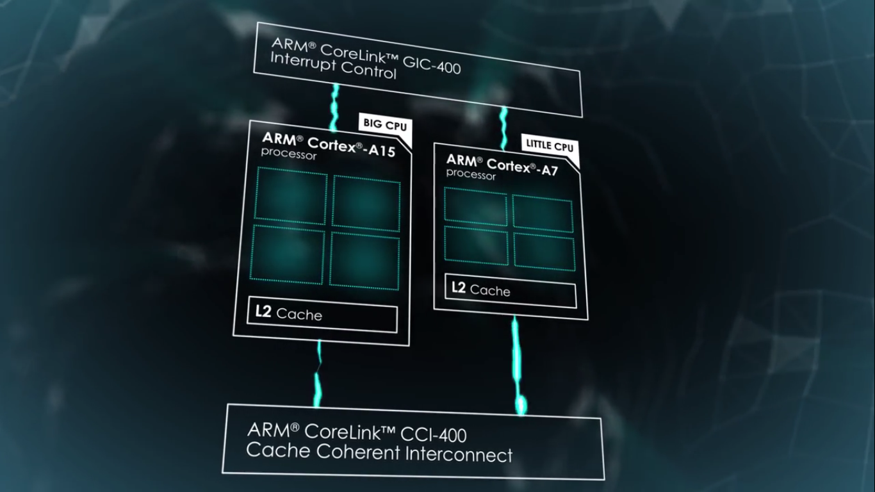
5. Special or Interesting Features: big.LITTLE
This is a power-optimization technology where
high-performance ARM CPU cores
are combined with
the most efficient ARM CPU cores
to deliver
peak-performance
capacity,
higher sustained performance, and
increased parallel processing performance,
at significantly lower average power.

Slide 33
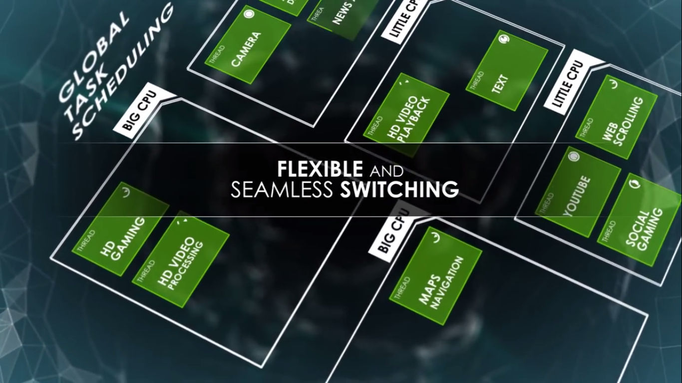
Special or Interesting Features: big.LITTLE
Global Task Scheduling
automatically and seamlessly moves workloads to the appropriate CPU core based on performance needs.
It takes advantage of the dynamic usage pattern for smartphones and tablets.
Periods of high processing intensity tasks such as initial web page rendering and game physics calculation
alternate with
typically longer periods of low processing intensity tasks such as scrolling or reading a web page, waiting for user input in a game, and lighter weight tasks like texting, e-mail and audio.

Slide 34
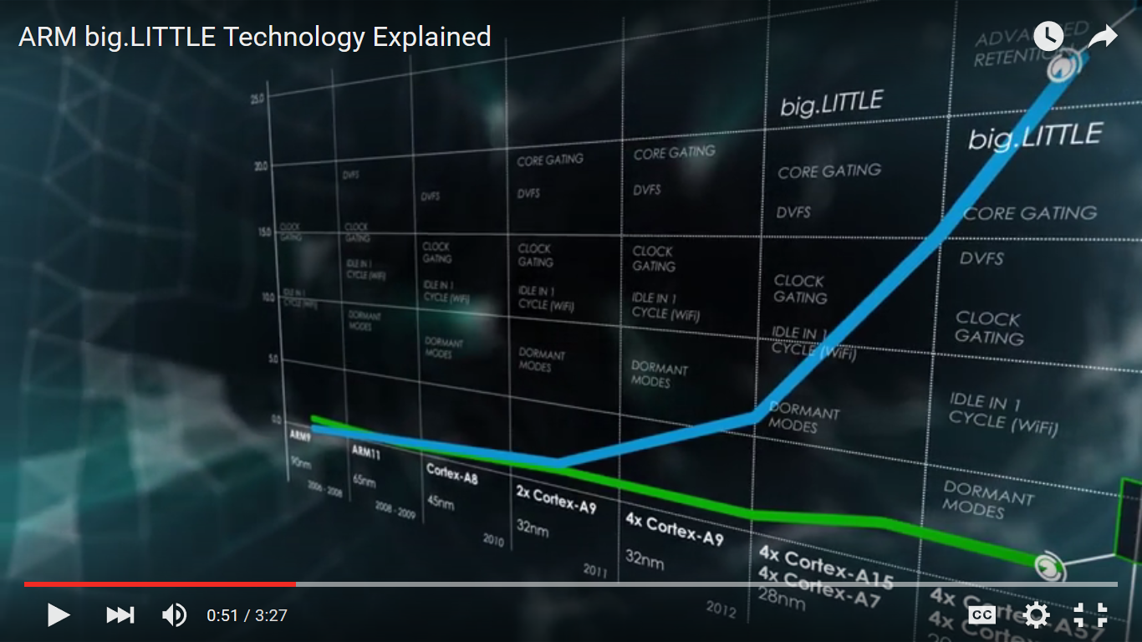
Summary
From analyzing the ARM Cortex-A9 architecture
I can say that both the
RISC Architecture and Harvard Architecture have had a strong influence on the processors success
ARM says that the following are Energy efficiency features:
accurate branch and return prediction, reducing the number of incorrect instruction fetch and decode operations
the use of physically addressed caches, reducing the number of cache flushes and refills, saving energy in the system
the use of micro TLBs reduces the power consumed in translation and protection lookups for each cycle
caches that use sequential access information to reduce the number of accesses to the tag RAMs and to unnecessary accesses to data RAMs
instruction loops that are smaller than 64 bytes often complete without additional instruction cache accesses, so lowering power consumption
New Features such as MPCore, GPU Compute and big.LITTLE continue to increase performance and efficiency.

Slide 35
Leigh Williamson, a Distinguished Engineer from IBM, says:
I really think that mobile is pretty quickly just going to be one channel of delivery for content and services. Already we are seeing a lot of interest in wearables, and some of the implementations related to those actually leverage the power of a mobile device. Mobile devices are getting more and more powerful with every release. They're almost being used now as an intermediate computing platform that bridges between some cloud-based backend services and a smaller wearable device like a wristwatch or an eyeglass device. The mobile phone or tablet becomes a powerful middle tier, with the ultimate endpoint being even more interesting and different than what we see today.

Slide 36
Thank You.

Slide 37
References
[1] AndroidAuthority. ARM vs X86 – Key Differences Explained! http://www.androidauthority.com/arm-vs-x86-key-differences-explained-568718/
[2] Broadcom. ARM’s Reach: 50 Billion Chip Mileston [VIDEO] http://www.broadcom.com/blog/chip-design/arms-reach-50-billion-chip-milestone-video/
[3] ARM. Cortex-A9 Processor http://www.arm.com/cortex-a9.php
[4] ARM. Big.LITTLE Technology https://www.arm.com/products/processors/technologies/biglittleprocessing.php
[5] U.S.News Money. The 100 Best Jobs http://money.usnews.com/careers/best-jobs/rankings/the-100-best-jobs
[6] U.S.News Money. Best Technology Jobs: Software Developer http://money.usnews.com/careers/best-jobs/software-developer
[7] Keynote. The New Challenges of Managing the Mobile App Lifecycle: A conversation with IBM’s Leigh Williamson about mobile application management https://www.keynote.com/resources/articles/new-challenges-managing-mobile-app-lifecycle
[8] Independent. There are officially more mobile devices than people in the world http://www.independent.co.uk/life-style/gadgets-and-tech/news/there-are-officially-more-mobile-devices-than-people-in-the-world-9780518.html
[9] Census. U.S. and World Population Clock http://www.census.gov/popclock/
[10] GSMA Intelligence. Global Data https://gsmaintelligence.com/
[11] SmartInsights. Mobile Marketing Statistics 2015: Statistics on mobile usage and adoption to inform your mobile marketing strategy http://www.smartinsights.com/mobile-marketing/mobile-marketing-analytics/mobile-marketing-statistics/
[12] Marketing Land. Report: Apple, Android Now 96 Percent of Smartphones Globally http://marketingland.com/report-apple-android-now-96-percent-smartphones-globally
[13] Bloomberg. ARM Designs One of the World’s Most Used Products. So Where is the Money? http://www.bloomberg.com/bw/articles/2014-02-04/arm-chips-are-the-most-used-consumer-product-dot-where-s-the-money
[14] ARM. Company Profile http://www.arm.com/about/company-profile/index.php
[15] Furber, Steve. ARM System Architecture. New York: Addison Wesley Longman Inc., 1996. Print.
[16] ARM. HARVARD VS VON NEUMANN http://infocenter.arm.com/help/index.jsp?topic=/com.arm.doc.faqs/ka11516.html
[17] ARM. Cortex-A9 Processor Microarchitecture http://web.archive.org/web/20110915171556/http://www.arm.com/files/downloads/Cortex-A9_Devcon_2007_Microarchitecture.pdf
[18] Englander, Irv. The Architecture of Computer Hardware, Systems Software & Networking: An information technology approach. 5th Edition. Hoboken: John Wiley & Sons, 2014. Print.
[19] ARM. ARM Processor Architecture http://www.arm.com/products/processors/instruction-set-architectures/index.php
[20] University of Washington. The ARM Architecture https://courses.cs.washington.edu/courses/cse466/10au/pdfs/lectures/07-arm_overview.pdf
[21] ARM. “The ARM University Program, ARM Architecture Fundamentals.” Online video clip. YouTube. YouTube, 24 Jun. 2013. Web. 15 Nov. 2015. https://www.youtube.com/watch?v=7LqPJGnBPMM
[22] SlideShare. The ARM Architecture http://www.slideshare.net/sreea4/arm-1
[23] ARMKeil: Embedded Development tools. Access to the Inline Barrel Shifter, 2015. http://www.keil.com/support/man/docs/armasm/armasm_dom1359731140200.htm
[24] ARM. https://www.arm.com/products/processors/technologies/vector-floating-point.php
[25] ARM. Cortex A-9 floating point unit Technical Reference Manual, page 1-3 http://infocenter.arm.com/help/index.jsp?topic=/com.arm.doc.ddi0388e/index.html
[26] ARM. Cortex A-9 Technical Reference Manual, http://infocenter.arm.com/help/index.jsp?topic=/com.arm.doc.ddi0388e/index.html
[27] ARM Developers’ Conference Oct 2007. “Details of a New Cortex Processor Revealed: Cortex-A9” http://rtcgroup.com/arm/2007/presentations/174%20-%20Details%20of%20a%20New%20Cortex%20Processor%20Revealed%20Cortex-A9.pdf
[28] Design & Reuse. The ARM Cortex-A9 Processors http://www.design-reuse.com/articles/16875/the-arm-cortex-a9-processors.html
[29] ARM. GPU Compute http://www.arm.com/files/event/2014_ARM_Multimedia_Seminar_ARM_Roberto_Mijat.pdf
[30] Forbes. ARM ‘All-In’ With Mobile GPU Compute http://www.forbes.com/sites/patrickmoorhead/2013/07/15/arm-all-in-with-mobile-gpu-compute/
[31] ARM. ARM big.LITTLE Technology Explained https://www.youtube.com/watch?v=KClygZtp8mA
[32] ARM. Ten Things to Know About big.LITTLE https://community.arm.com/groups/processors/blog/2013/06/18/ten-things-to-know-about-biglittle

